Slide 1
Computer Graphics: Introduction to OpenGL
Tommy Marrinan, PhD
*Content borrowed from SIGGRAPH 2013 – An Introduction to OpenGL Programming

Slide 2
What is OpenGL?
OpenGL = Open Graphics Language
OpenGL is a computer graphics rendering API
Used to generate high-quality color images by rendering geometric primitives
Operating System independent
Window system independent

Slide 3

OpenGL 1.0
Released 1994
Fixed-function pipeline
Vertex Data
Vertex Transform and Lighting
Primitive Setup and Rasterization
Fragment Coloring and Texturing
Blending
Pixel Data
Texture Store

Slide 4
OpenGL 3.1
Released 2009
Removed fixed-function pipeline
Required use of shaders
Shaders are small programs that execute on the GPU – many instances of the same program run in parallel
Vertex Data
Vertex Shader
Primitive
Setup and Rasterization
Fragment Shader
Blending
Pixel Data
Texture Store

Slide 5
Vertex Shader
One instance per vertex in a model
Primary purpose is to transform 3D model into 2D screen coordinates
Vertex Position
Vertex Data Input (color, normal, etc.)
Vertex Position Transformation
Transformed Vertex Position
Uniform Data
Vertex Shader

Slide 6
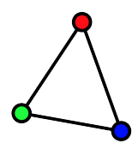
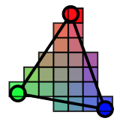
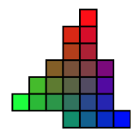
Fragment Shader
One instance per fragment (pixel) in each rasterized triangle of a model
Primary purpose is to determine the color of a pixel
Vertex Data Output (interpolated)
Uniform Data and Textures
Vertex Data Interpolated
Final Pixel Color
Fragment Shader

Slide 7
OpenGL 3.1
Almost all data became GPU-resident
All vertex data sent using buffer objects
Vertex Data
Vertex Shader
Primitive
Setup and Rasterization
Fragment Shader
Blending
Pixel Data
Texture Store

Slide 8
OpenGL ES
OpenGL ES 2.0
Designed for embedded and hand-held devices
Based on OpenGL 3.1
WebGL uses this!
OpenGL ES 3.0
Multiple render targets
Additional texturing capabilities (3D textures!)
WebGL2 uses this!

Slide 9
Simplified Shader Pipeline
Application
GPU Data Flow
Framebuffer
Vertices
Vertices
Fragments
Pixels
Vertex Processing
Rasterizer
Fragment Processing
Vertex
Shader
Fragment
Shader

Slide 10
OpenGL Programming in a Nutshell
Modern OpenGL programs essentially do the following
Create shader programs
Create buffer objects and load data into them
“Connect” data locations with shader variables
Render

